Slide 1
Factorising Bingo
Aim: 3 in a row
Grid: 9 Grid
Play: Calculate answer & cross it off

Slide 2
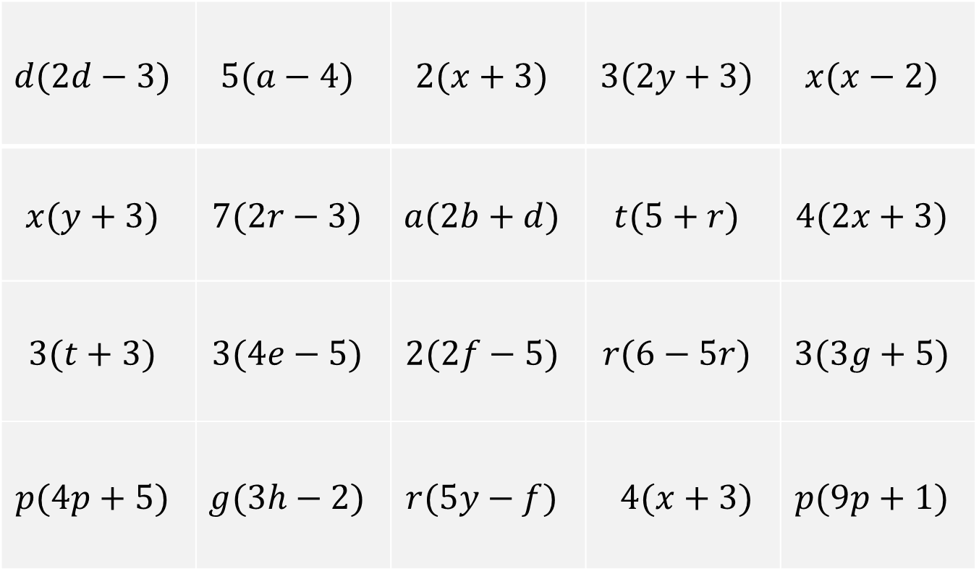
Choose 9 expressions
$$d(2d−3)$$ | $$5(a−4)$$ | $$2(x+3)$$ | $$3(2y+3)$$ | $$x(x−2)$$
$$x(y+3)$$ | $$7(2r−3)$$ | $$a(2b+d)$$ | $$t(5+r)$$ | $$4(2x+3)$$
$$3(t+3)$$ | $$3(4e−5)$$ | $$2(2f−5)$$ | $$r(6−5r)$$ | $$3(3g+5)$$
$$p(4p+5)$$ | $$g(3h−2)$$ | $$r(5y−f)$$ | $$4(x+3)$$ | $$p(9p+1)$$

Slide 3

Question
$$5t+rt$$

Slide 4

Question
$$9p2+p$$

Slide 5

Question
$$8x+12$$

Slide 6

Question
$$3t+9$$

Slide 7

Question
$$4x+12$$

Slide 8

Question
$$2ab+ad$$

Slide 9

Question
$$9g+15$$

Slide 10

Question
$$x2−2x$$

Slide 11

Question
$$5a−20$$

Slide 12

Question
$$5ry−rf$$

Slide 13

Question
$$2d2−3d$$

Slide 14

Question
$$6y+9$$

Slide 15

Question
$$4p2+5p$$

Slide 16

Question
$$2x+6$$

Slide 17

Question
$$4f−10$$

Slide 18

Question
$$6r−5r2$$

Slide 19

Question
$$14r−21$$

Slide 20

Question
$$xy+3x$$

Slide 21

Question
$$12e−15$$

Slide 22

Question
$$3gh−2g$$

